Slide 1
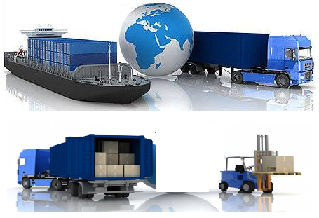
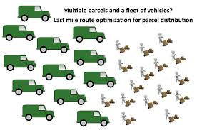
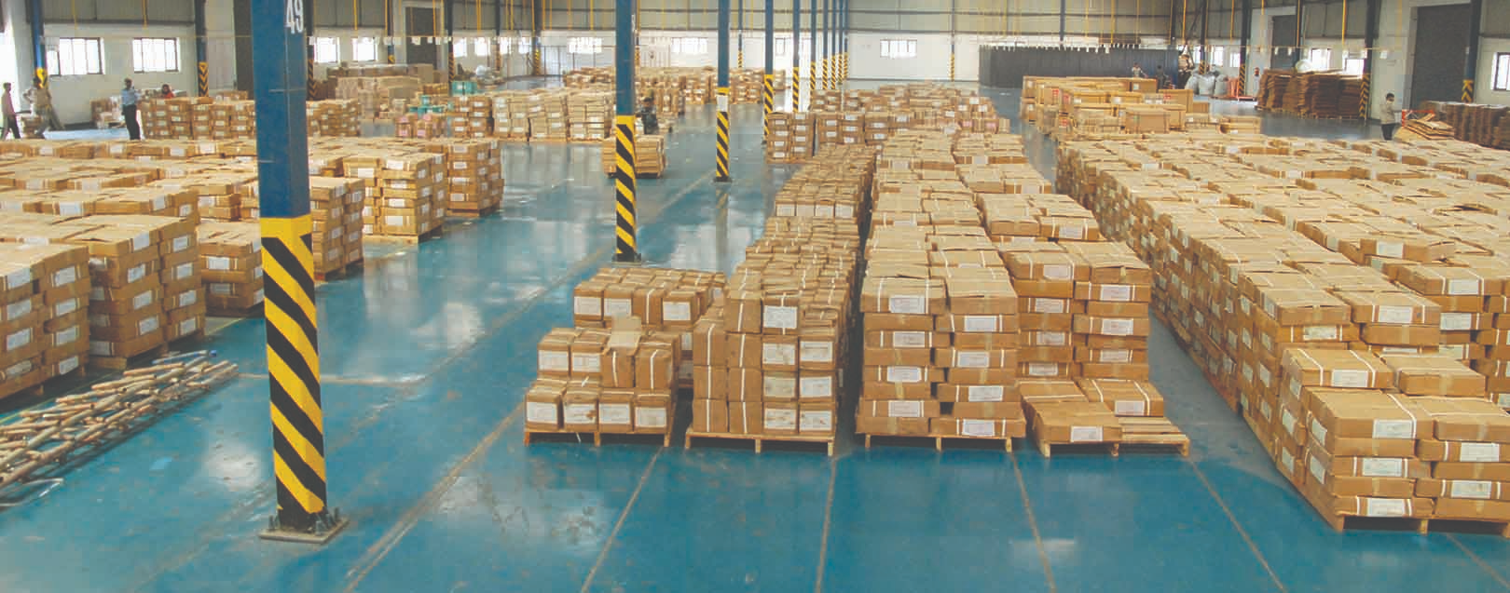
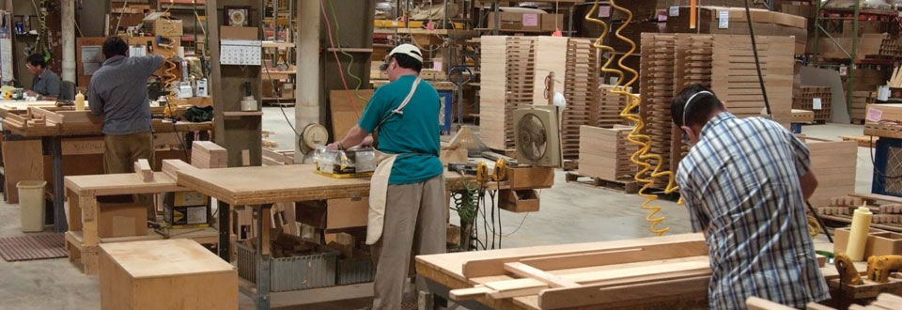
Stove Logistics Plan
Importation
Warehousing
Distribution
Service & Warranty
Updated 19 Nov 2018

Slide 2
OBJECTIVES
OUTLINE THE KEY PROCESSES
GET FEEDBACK ON DEPENDENCIES
ADDRESS EXPECTATIONS ON SERVICE DELIVERIES

Slide 3
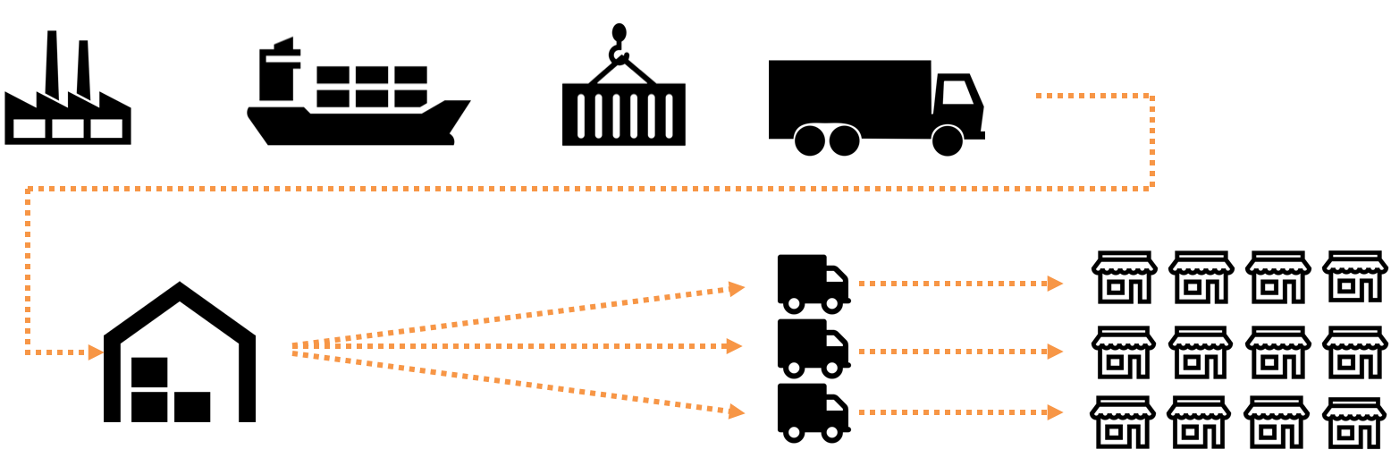
PROCESS OVERVIEW
1. May go as high as 4.2 USD / stove based on latest dimensions
2. Can be reduced to 0.17 USD / stove if insourced
3. Can be reduced to 1.0 USD / stove if insourced
4. Currently, congestion is being experienced, adding 1 week
7 days
15 days
4 days ⁴
1 day ⁴
Trial Run Data
(Validating Assumptions)
3.8 USD / Stove
0.3 USD / Stove ²
1.4 USD / Stove ³
- 5,000 stoves inbound / outbound per week
- Scanning used to process stoves faster
- Approx 6-7 man hours to unload one container
- Average delivery size = 5 stoves
- Capability to make 20 deliveries per truck per day
- Approx 100 stoves delivered per truck
- 10 trucks needed

Slide 4
KEY STAKEHOLDERS
Marketing
Deployment
Procurement
ICT
Software & Third Party Tools
Odoo System, Loginext API
Agent Management
Transporters
CIVIL WORKS
Distribution Planning
Distribution Execution
15 April 2019 Onwards to HL

Slide 5
IMPORTATION PROCESS
Proforma invoice sent 2 weeks in advance prior to shipping
IDF processing within 3 working days
Pre- inspection at origin 5-7 working days
Export documentation -2 days
Expected Outcome
Whole process to take 28 days Max
Risks
Delays in receiving proforma invoice
Lack of required government requested documents at time of IDF application
Tradex system downtime
Name not in government system for importation of specific items with other government bodies.
Non conformity at pre-inspection
Delays in vessel arrival by not using direct vessels.
Port congestion / Simba system downtime
Theft / damage of items
Delivery to warehouse at Baba dogo
Custom clearance at destination within 5-7 days of vessel arrival
Shipping using (direct vessel that takes 11-15 days to arrive at destination)
Solutions/Controls
Proforma invoice to be sent 2 weeks before shipping
User department to advise procurement / logistics on government requirements on the specific products before placing order
Ensure items are bought from compliant manufacturers
Ensure booking on direct vessels
Good warehouse management controls

Slide 6
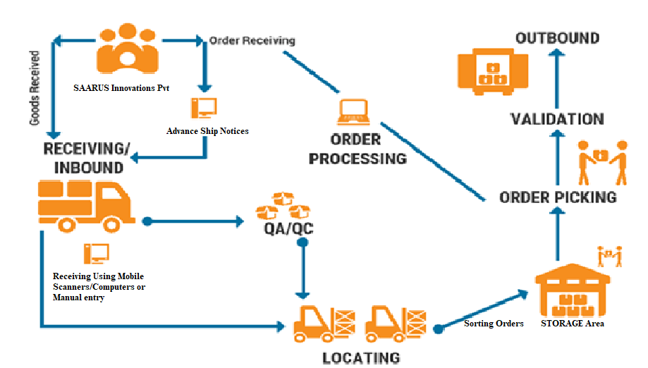
WAREHOUSE MANAGEMENT
NOTES
Inbound of 5k/per week
Storage area for 2-3 weeks stock
Outbound stock for 200 locations per day
Risk
Theft of items when on transit to the warehouse
Damage of goods while being offloaded
stock traceability
Solutions /Controls
Ensure we get trucks from reliable and trustworthy transporters
Ensure incase of inhouse lose same is pegged to their salary
Ensure we get a warehouse in a safe secure place with good security

Slide 7
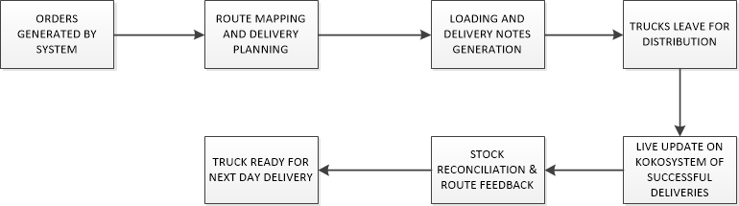
DISTRIBUTION PROCESS
Risk
Generated stock out more than we can handle
Agents not informed at all /in good time in regards to our planned delivery
traffic accidents & delays on the road
Unavailability of trucks or transport companies sending less trucks than what was agreed upon..
Tools allocated to driver not working or haven’t been charged
SOLUTIONS /CONTROLS
Initiate mandatory planning of all stock outs before we can proceed to generate
Ensure the system is working efficiently at all times
To have at least three pre qualified transporters incase of any eventuality
Ensure all the tools we intend to use are in good working condition (offline data storage)

Slide 8
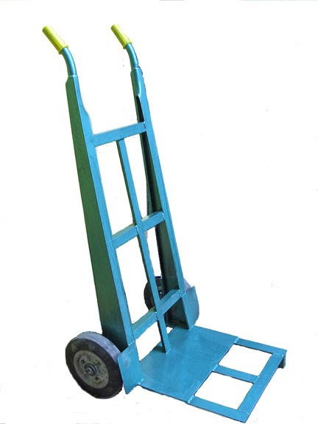
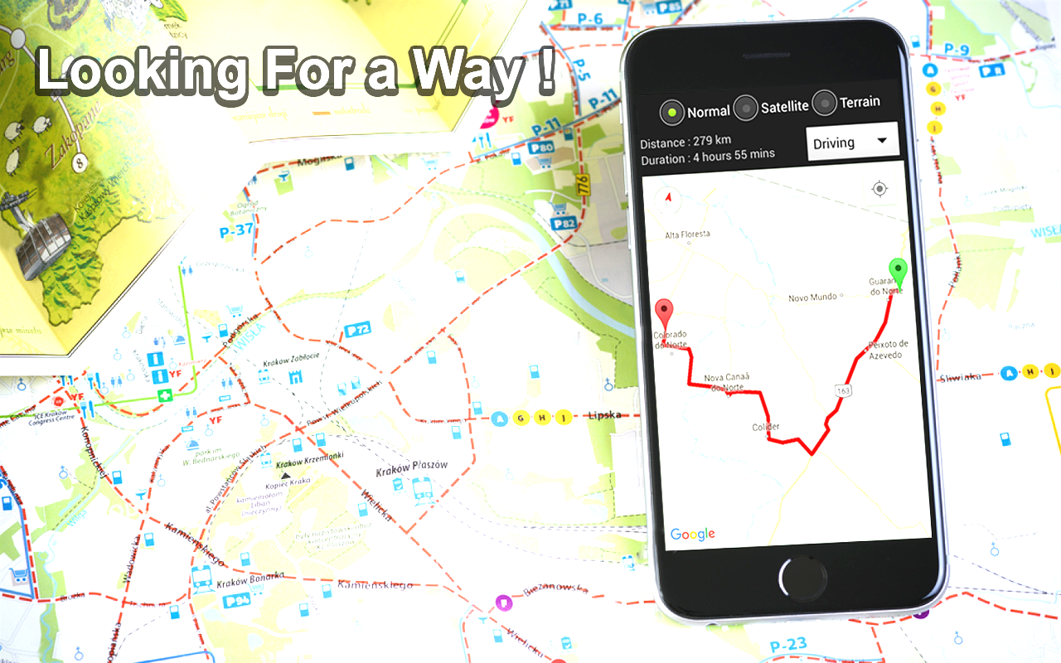

Tools to be used for delivery and handover
Mobile route Planner App (Loginext)
Code Scanner
Dolly/Trolley

Slide 9
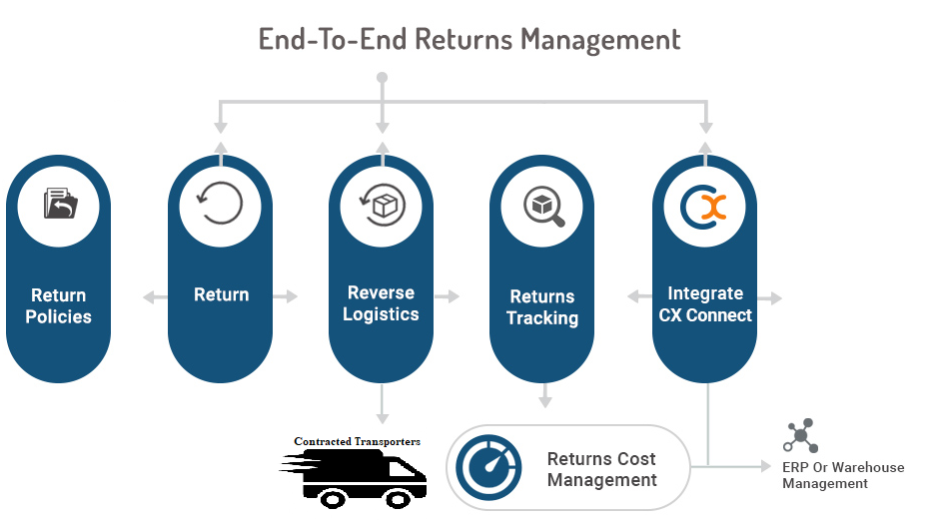
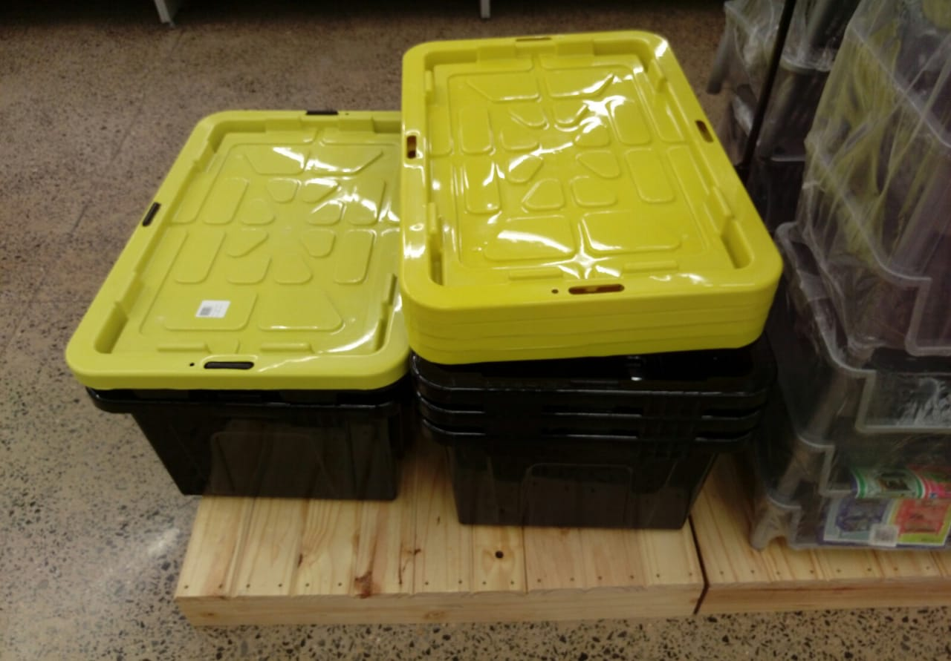
Returns Management
Suggested Returns Bins

Slide 10
How we get There Timelines
RFQ sent for shipping, clearance, warehousing, & transportation
Decision on Warehousing Made and contract negotiation underway
Order Quantities agreed on and storage space needed locked in
New hires onboarded and ERP and Stove logistics Process training done. Relocation to new warehouse facility underway,
Shipping & Transport contracts in place,
Warehouse Operational,
All systems up & running,
First batch of stoves received and Distribution underway
Send out RFP, for shipping, customs cwarehousing & transport
Contract Negotiations started
31 Nov 2018
15 Mar 2019
22 Apr 2019
Hard Launch
31 Jan 2019
30 Mar 2019
ERP System In Place,
Manpower interviewed and job offers finalised
Stove distribution model signed off
Distribution set up at new facility underway, orders for furniture, computers, etc underway

Slide 11
Performance Matrix
Measuring our Performance
INTERNAL KPI’S
On time Deliveries
Inventory accuracy
Order cycle time
Workforce utilisation
Shipping accuracy
Truck loading rate
Order entry accuracy
Customer Satisfaction
Stock losses
TRANSPORTER KPI’S
Transport Cost/Order value
On time deliveries
Lead time
Ethics/ Compliance
Task Completion rate
Handover times
Transit times
Stock losses
AGENT KPI’S
Sales Volumes
Order frequency
Cost to serve
Time to serve
Successful deliveries
Returns Rate
Agent satisfaction
Stock losses

Slide 12
Truck Lease vs Buy Analysis - Cash-flow over 24 Months (USD)
Lease |  |  | Difference | Buy
 | Monthly | 24 Months |  |  | Monthly | 24 Months
Up front cost | 0 | 0 |  | Up front cost | 27,000 | 27,000
Fixed cost (per month) | 3080 | 73,920 |  | Fixed cost (per month) | 596 | 14,754
 |  |  |  | Variable cost (per month) | 845 | 20,275
TOTAL |  | 73,920 | -11,891 USD | TOTAL |  | 62,029

